Slide 1
CUDA optimization
Fabric Draping
CS 750 High performance computing – Course project

Slide 2
Contents
Draping Introduction
Blossom Polynomials
Problem definition and Inputs
Parallelized Reduction Algorithm
CUDA basics
Results
References

Slide 3

Draping
Draping of virtual characters is done using cloth simulation models.
The Fabric needs to be rendered and simulated in a time efficient manner.
CUDA optimization can help lower the time required to achieve this.
For maximum performance and process control, we choose programming language C++.

Slide 4


Rendering process
Physical simulation
CAD model of the target
Target feature points
Grid of points for fabric
Fully Rendered Fabric on Target
Fabric geometry

Slide 5
Our scope
Scope of project
Converting a grid of control points into a fabric geometry
Grid of points for fabric
Fabric geometry

Slide 6
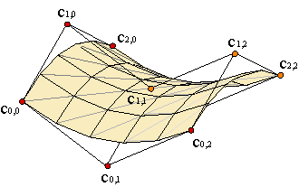
B-Spline surface

Slide 7
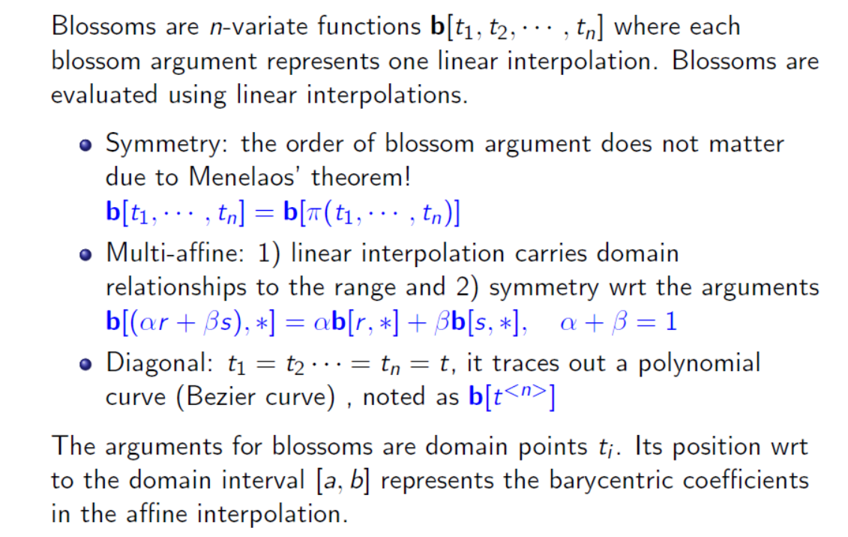
Blossoming polynomials

Slide 8
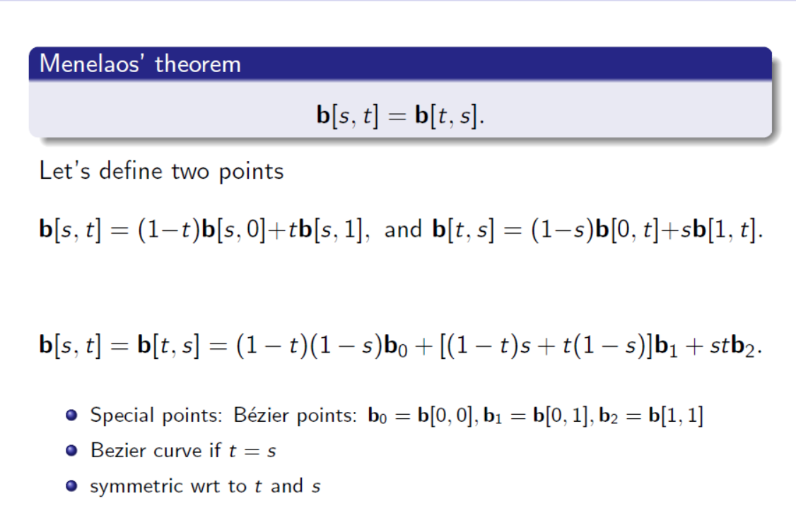
Bi-variate Blossom : Quadratic Bspline

Slide 9
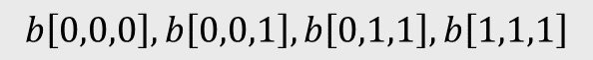
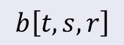
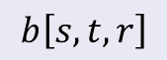
Tri-variate Blossom : Cubic Bspline
$$b\left[s,t,r\right]$$
$$b\left[t,s,r\right]$$
$$b\left[s,t,r\right]=\left(1−s\right)\left(1−t\right)\left(1−r\right)b_{0}+Σ\left(1−t\right)\left(1−s\right)rb_{1}+Σ\left(1−s\right)trb_{2}+strb_{3}$$
$$b\left[0,0,0\right],b\left[0,0,1\right],b\left[0,1,1\right], b\left[1,1,1\right]$$

Slide 10
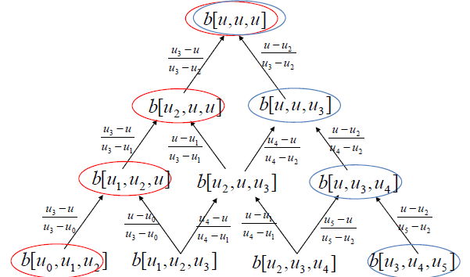
B-spline Construction

Slide 11



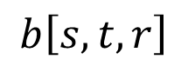
B-spline Construction
$$b\left[s,t,r\right]$$
Blossom Construction
$$r$$
$$t$$
$$s$$

Slide 12
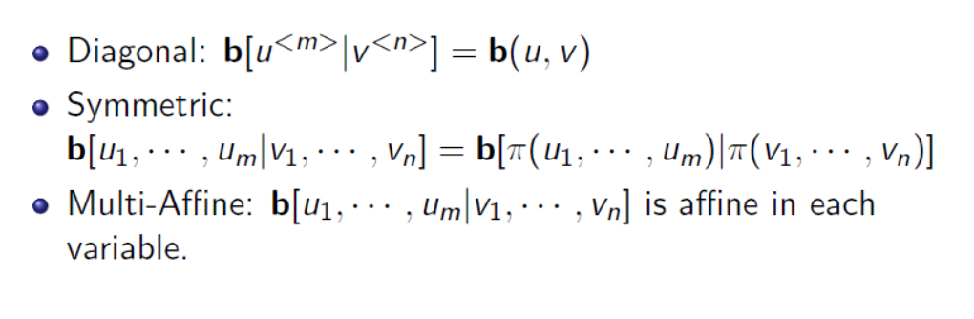
Surface blossoms

Slide 13
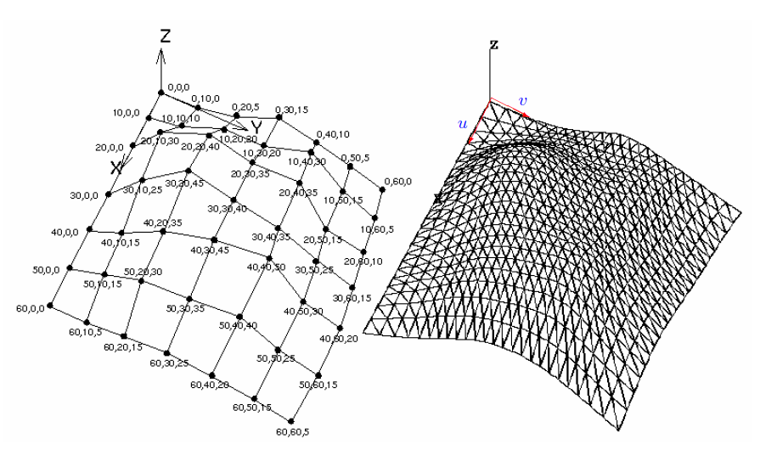
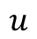
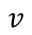
Grid of Control Points + u,v grid
$$v$$
$$u$$

Slide 14
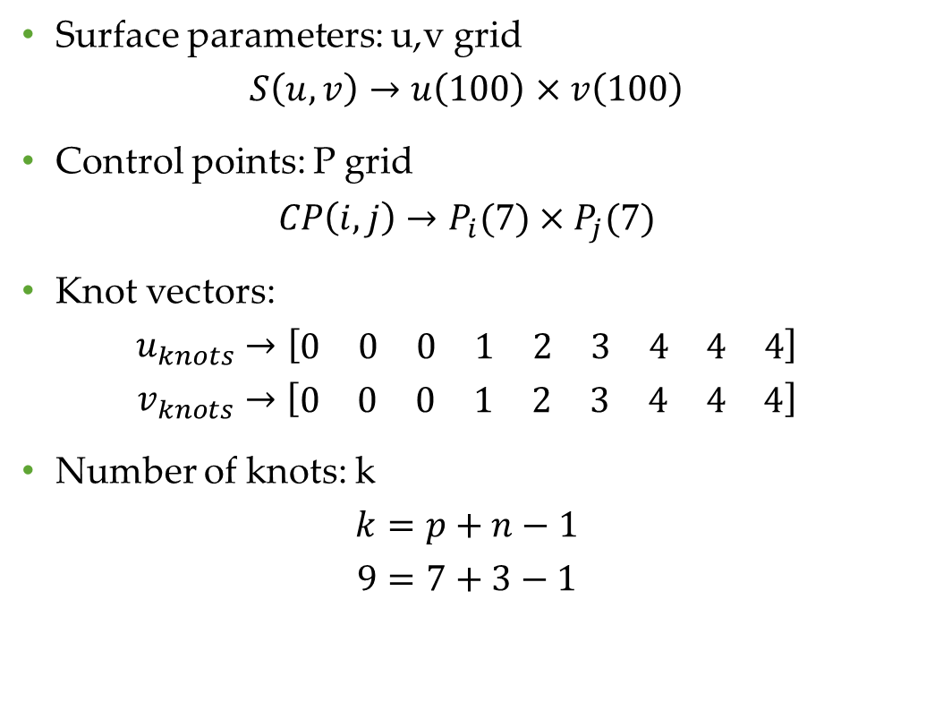
Inputs
Surface parameters: u,v grid
$$S\left(u,v\right)→u\left(100\right)×v\left(100\right)$$
Control points: P grid
$$CP\left(i,j\right)→P_{i}(7)×P_{j}(7)$$
Knot vectors:
$$u_{knots}→\left[\begin{matrix}0 & 0 & 0 & 1 & 2 & 3 & 4 & 4 & 4\end{matrix}\right]$$
$$v_{knots}→\left[\begin{matrix}0 & 0 & 0 & 1 & 2 & 3 & 4 & 4 & 4\end{matrix}\right]$$
Number of knots: k
$$k=p+n−1$$
$$9=7+3−1$$
Grid of points for fabric
u, v coordinates
Fabric geometry

Slide 15
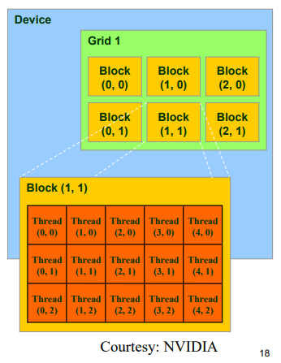
CUDA Intro
CUDA virtualizes the physical hardware into threads and blocks
Threads
Thread is a virtualized Scalar Processor
Blocks
Thread blocks is a virtualized Streaming multiprocessor.
Thread blocks need to be independent
They run to completion.
Order of blocks is undecided.

Slide 16
B-spline basis Construction

Slide 17
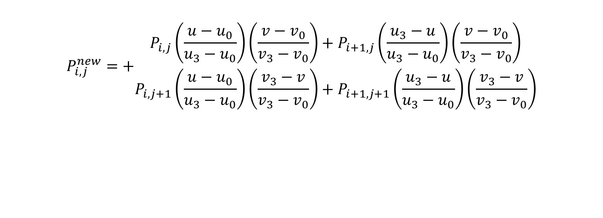
Thread(i,j): Across domain
$$P_{i,j}^{new}=+\begin{matrix}P_{i,j}\left(\frac{u−u_{0}}{u_{3}−u_{0}}\right)\left(\frac{v−v_{0}}{v_{3}−v_{0}}\right)+P_{i+1,j}\left(\frac{u_{3}−u}{u_{3}−u_{0}}\right)\left(\frac{v−v_{0}}{v_{3}−v_{0}}\right) \\ P_{i,j+1}\left(\frac{u−u_{0}}{u_{3}−u_{0}}\right)\left(\frac{v_{3}−v}{v_{3}−v_{0}}\right)+P_{i+1,j+1}\left(\frac{u_{3}−u}{u_{3}−u_{0}}\right)\left(\frac{v_{3}−v}{v_{3}−v_{0}}\right)\end{matrix}$$

Slide 18
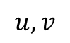
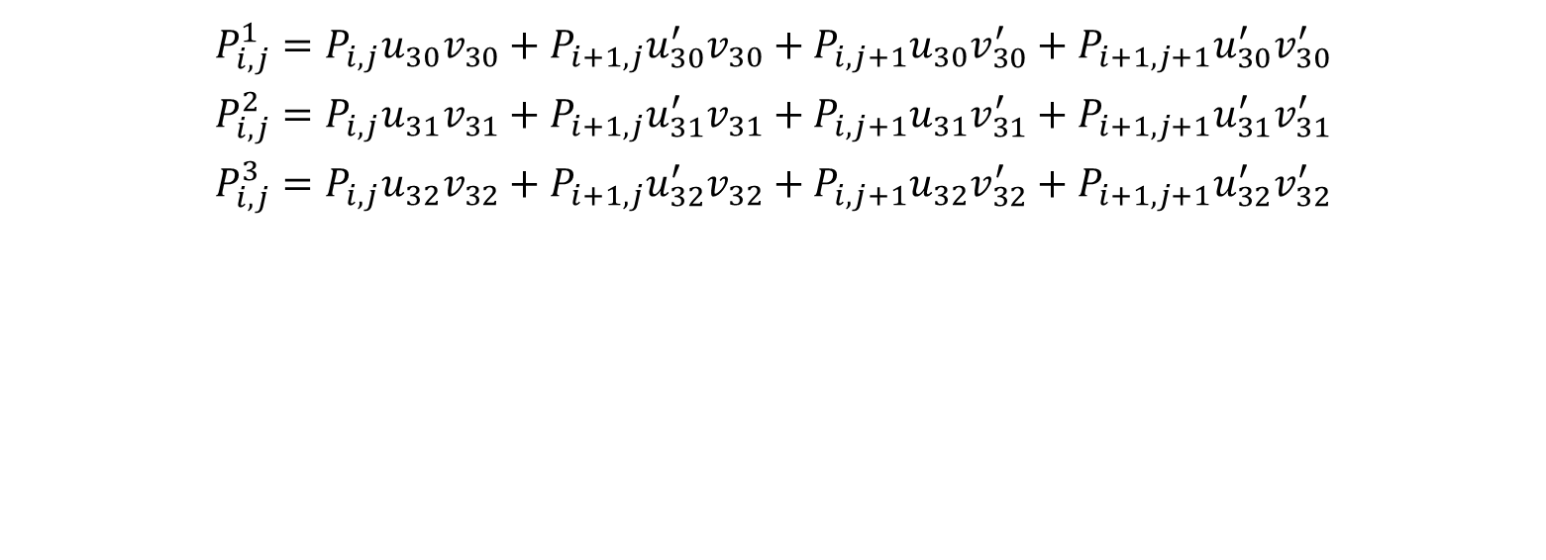
Block(i_{b},j_{b}) = 16 threads/ Per Block = 1 grid point (u,v)
$$P_{i,j}^{1}=P_{i,j}u_{30}v_{30}+P_{i+1,j}u_{30}^{′}v_{30}+P_{i,j+1}u_{30}v_{30}^{′}+P_{i+1,j+1}u_{30}^{′}v_{30}^{′}$$
$$P_{i,j}^{2}=P_{i,j}u_{31}v_{31}+P_{i+1,j}u_{31}^{′}v_{31}+P_{i,j+1}u_{31}v_{31}^{′}+P_{i+1,j+1}u_{31}^{′}v_{31}^{′}$$
$$P_{i,j}^{3}=P_{i,j}u_{32}v_{32}+P_{i+1,j}u_{32}^{′}v_{32}+P_{i,j+1}u_{32}v_{32}^{′}+P_{i+1,j+1}u_{32}^{′}v_{32}^{′}$$
$$u,v$$

Slide 19
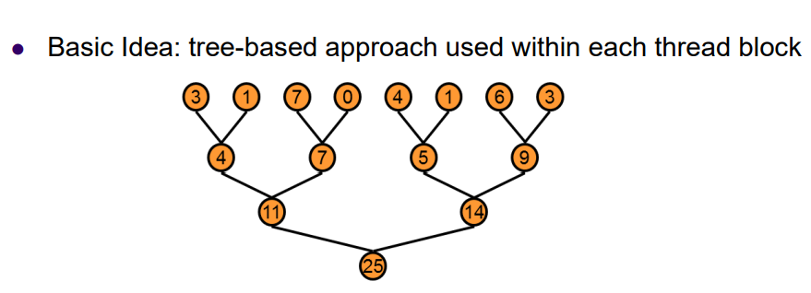

Parallel Reduction Operation : $A⊕B=C$

Slide 20
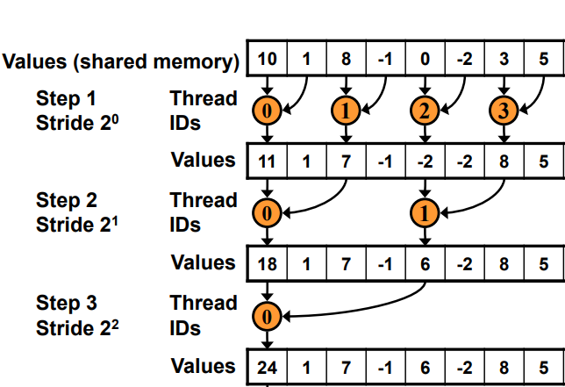
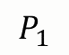
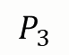
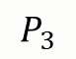
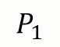
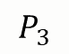
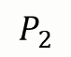
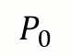
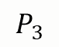
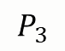
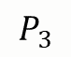
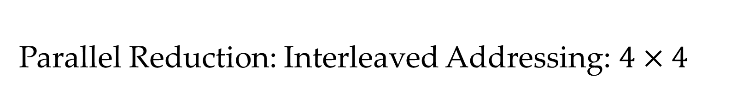
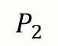
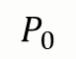
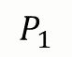
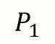
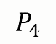
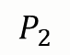
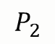
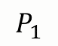

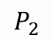
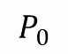
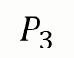
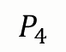
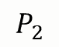
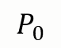
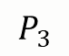

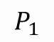

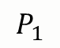
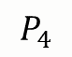
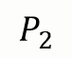
Parallel Reduction: Interleaved Addressing: $4×4$
$$P_{0}$$
$$P_{1}$$
$$P_{1}$$
$$P_{2}$$
$$P_{2}$$
$$P_{3}$$
$$P_{3}$$
$$P_{4}$$
$$P_{0}$$
$$P_{1}$$
$$P_{1}$$
$$P_{2}$$
$$P_{2}$$
$$P_{3}$$
$$P_{3}$$
$$P_{4}$$
$$P_{0}$$
$$P_{1}$$
$$P_{1}$$
$$P_{2}$$
$$P_{2}$$
$$P_{3}$$
$$P_{3}$$
$$P_{4}$$
$$P_{0}$$
$$P_{1}$$
$$P_{1}$$
$$P_{2}$$
$$P_{2}$$
$$P_{3}$$
$$P_{3}$$
$$P_{4}$$

Slide 21
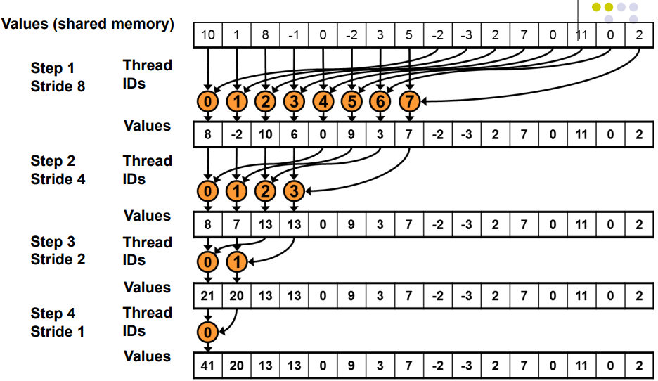


























Parallel Reduction: Sequential Addressing
$$P_{0}$$
$$P_{1}$$
$$P_{2}$$
$$P_{3}$$
$$P_{4}$$
$$P_{5}$$
$$P_{6}$$
$$P_{7}$$
$$P_{1}$$
$$P_{2}$$
$$P_{3}$$
$$P_{4}$$
$$P_{5}$$
$$P_{6}$$
$$P_{7}$$
$$P_{8}$$
$$P_{0}$$
$$P_{1}$$
$$P_{2}$$
$$P_{3}$$
$$P_{4}$$
$$P_{5}$$
$$P_{6}$$
$$P_{7}$$
$$P_{1}$$
$$P_{2}$$
$$P_{3}$$
$$P_{4}$$
$$P_{5}$$
$$P_{6}$$
$$P_{7}$$
$$P_{8}$$
$$P_{0}$$
$$P_{1}$$
$$P_{2}$$
$$P_{3}$$
$$P_{4}$$
$$P_{5}$$
$$P_{6}$$
$$P_{7}$$
$$P_{1}$$
$$P_{2}$$
$$P_{3}$$
$$P_{4}$$
$$P_{5}$$
$$P_{6}$$
$$P_{7}$$
$$P_{8}$$
$$P_{0}$$
$$P_{1}$$
$$P_{2}$$
$$P_{3}$$
$$P_{4}$$
$$P_{5}$$
$$P_{6}$$
$$P_{7}$$
$$P_{1}$$
$$P_{2}$$
$$P_{3}$$
$$P_{4}$$
$$P_{5}$$
$$P_{6}$$
$$P_{7}$$
$$P_{8}$$
$$P_{0}$$
$$P_{1}$$
$$P_{2}$$
$$P_{3}$$
$$P_{4}$$
$$P_{5}$$
$$P_{6}$$
$$P_{7}$$
$$P_{1}$$
$$P_{2}$$
$$P_{3}$$
$$P_{4}$$
$$P_{5}$$
$$P_{6}$$
$$P_{7}$$
$$P_{8}$$

Slide 22

Warps (Scheduling unit)
Each warp runs threads in a lock step fashion

Slide 23

Data transfer rates

Slide 24


Slide 25

Memory hierarchy

Slide 26

Code walk through
__Global__ function is called from the host and runs on the device.
* variables are for input and output.
__Shared variables are shared across the threads within a block.

Slide 27

Thread and Block IDs obtained
Thread ID i,j select the control points for each reduction operation.
Block ID ib,jb select the u,v grid co-ordinate.

Slide 28

Barriers an Thread Synchronization
__syncthreads ensures all threads within a block have reached here.
Used to prevent memory conflicts and race conditions from occurring.
Use atomic operations key words like and volatile, to prevent race conditions.

Slide 29
CUDA memory management.
Memory Allocation
Data transfer from host to device.
Data transfer from device to host.

Slide 30


Slide 31


Slide 32


Slide 33


Slide 34


Slide 35

Nsight : Visual Studio

Slide 36

NVVP

Slide 37

NVVP

Slide 38

Results
Sample duration: (without yarn info)
Cuda time (ms)= 1.227840
Sequential time (ms) = 4.081682
Speed up factor :3.33
Tolerance<1e-4

Slide 39

CUDA streams for Asynchronous data transfer

Slide 40

Profiler

Slide 41
References
CUDA
NVIDIA, GPU Programming Guide, Version 8.0.
http://docs.nvidia.com/cuda/cuda-c-programming-guide/index.html
CS 759 Slides: High Performance Computing applications for Engineering
Jason Sanders and Edward Kandrot: CUDA by Example: An Introduction to General-Purpose GPU Programming, Addison-Wesley Professional, 2010
Lecture1.pdf (bu.edu)
Graphics
ME 535 slides : CAGD
Yuksel, C., Kaldor, J. M., James, D. L., & Marschner, S. (2012). Stitch meshes for modeling knitted clothing with yarn-level detail. ACM Transactions on Graphics (TOG), 31(4), 1-12.

